Slide 1
Teaching University Students: First Steps
SG 8001

Slide 2
Teaching University Students First Steps
Intended Learning Outcomes of this course (CILOs):
1. | Describe the context for learning and teaching at City University of Hong Kong.
2. | Apply Outcomes-Based Teaching and Learning (OBTL) approach in student learning.
3. | Utilize elearning tools in teaching.
4. | Deliver a high quality teaching and learning activity.

Slide 3
Syllabus
Workshop | Topic | Instructor | S01 | S02
Session 1 | The Context for Learning at City University of Hong Kong | Dr Lam Yee Man | 17 Sep | 31 Oct
Session 2 | Outcomes-Based Teaching & Learning | Dr Lam Yee Man | 19 Sep | 5 Nov
Session 3 | Teaching and Learning Activities for Undergraduate Students | Dr Patrio Chiu | 24 Sep | 7 Nov
Session 4 | Assessment Tasks: Assessment for Learning | Dr Patrio Chiu | 26 Sep | 12 Nov
Session 5 | Teaching Techniques: Practical Tips | Dr Patrio Chiu | 3 Oct | 14 Nov
Session 6 | Technology-Enhanced Learning | Dr Leon Lei | 8 Oct | 19 Nov
Session 7* | Conducting Laboratory | Dr Leon Lei | 10 Oct | 21 Nov
Assessment | Individual Presentation (Simulated Teaching Session with Interactive TLA and Assessment Plan) by Video | All instructors | Due 17 Oct | Due 28 Nov
*For students with laboratory duty

Slide 4
Intended Learning Outcomes
By the end of today’s session, you should be able to:
Describe the family background and learning style of CityU students
List CityUHK’s expectations of graduate outcomes
Analyse the possible role of a teacher
Session One

Slide 5

Where are you from?
Mentimeter!
Local (Hong Kong, SAR)
South-east Asia
South Asia and Central Asia
East Asia (not Mainland China)
Australia/New Zealand
Middle East
Europe
Africa
North/South America
Mainland China
Other

Slide 6
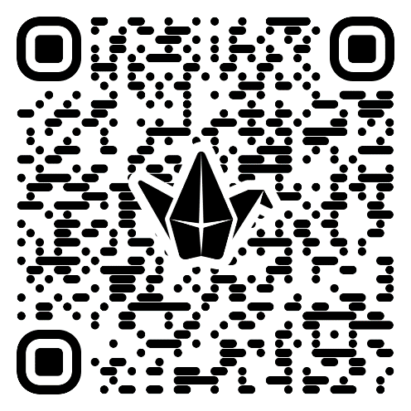
Question: In your opinion, what are your expectations of tutors?
Padlet!

Slide 7
Professors’ expectations on tutors at CityUHK
What are your expectations on tutors?
What kind of duties you would like them to handle?
Conduct tutorial: Explain lecture materials, guide students to do exercises, answer students’ questions on assignments
Grade assignment/quiz/test: Provide fair and responsible grading
Conduct Laboratory sessions: Guide students to conduct experiment

Slide 8
Question
What challenges (or worries) come with being a tutor?
Padlet!

Slide 9
Our Observations on GTAs
Confuse about teaching duties at CityU
Worry about conducting teaching duties will consume their time for research activities
May have problem in using English to teach/to explain materials

Slide 10

Teaching duty (Guidebook for Research Degree Studies)
Appendix 17: Regulations Governing Postgraduate Studentships
Studentship Renewal and Periodic Checking
The Postgraduate Studentship is normally granted on a yearly basis and is subject to renewal…. Students’ performance in any academic-related duties…will also be taken into account when being considered for studentship renewal.
Conditions
Studentship recipients are normally required to undertake up to six hours of academic-related duties per week
Discontinuation/Suspension of the Award
A student’s award shall be discontinued in the event of one of the following:
(c) unsatisfactory performance in academic-related duties as reported by the Department;

Slide 11

Teaching is Good for YOU!

Slide 12
Do you think that you will benefit from teaching?
Padlet!

Slide 13
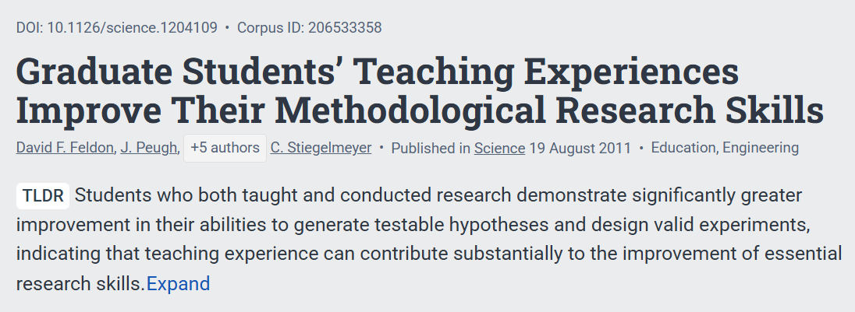

Slide 14
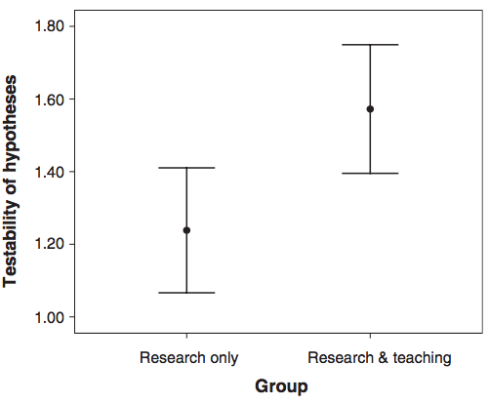
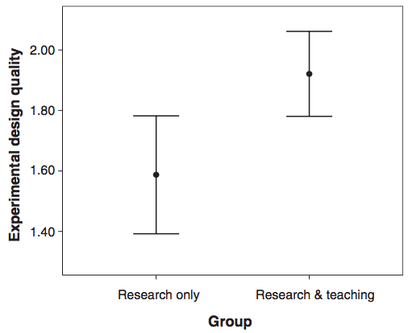
Teaching vs Research
“Teaching experience can contribute substantially to the improvement of essential research skills.”
Feldon et al. (2011). Graduate students' teaching experiences improve their methodological research skills. Science, 333(6045), 1037-1039.
Notes:
a group of researchers followed up nearly a hundred postgraduate students in 3 universities in the eastern USA and assessed their ability in writing research proposal with and without teaching duties. They found that when postgraduate students have research and teaching duties, they could produce better quality in testable hypotheses and valid experimental design compared to those students with research only. They concluded that teaching experience can contribute substantially to the improvement of essential research skills.

Slide 15
CityU Graduate Outcomes
On graduation, CityUHK’s research degree graduates will be able to:
Become an independent scholar
Conceptualise methodically
Strategise competitively
Apply results beneficially
Communicate professionally
https://www.cityu.edu.hk/qac/city_university_graduate_outcomes.htm

Slide 16
Open Question Do you think CityUHK students come from affluent families?
Padlet!

Slide 17
Background of CityU students: 2021-22 Cohort
This survey was taken by new students enrolled in UGC-funded programs
2,832 students newly admitted to nominative 4-year degrees, Advance Standing I & II as well as 111 new students to Associate Degree programmes. However, incoming exchange and visiting students are excluded.
NOTE: Data cannot be used, reproduced, or redistributed in other courses/project/activities…etc.

Slide 18
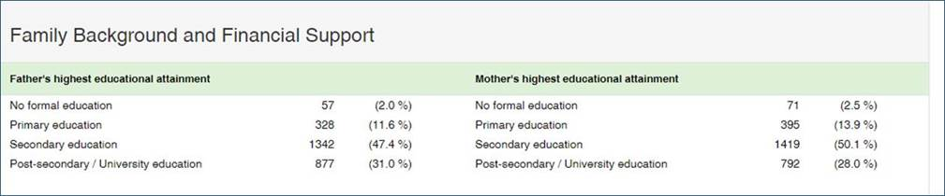
Family Education

Slide 19
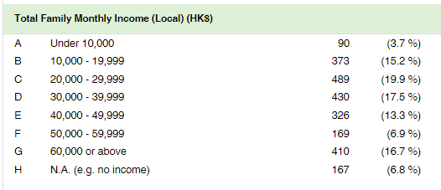
Family Income (local)

Slide 20
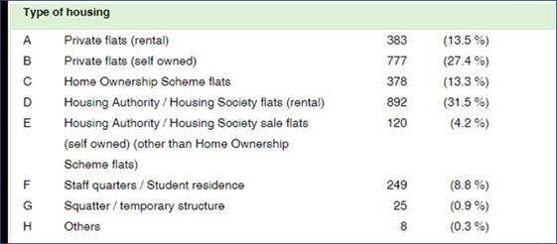
Type of Housing

Slide 21
Quick question
Do you have your own bedroom at home?
Padlet!

Slide 22
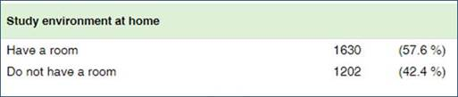
Study Environment at Home

Slide 23
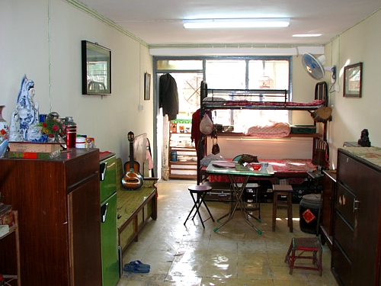
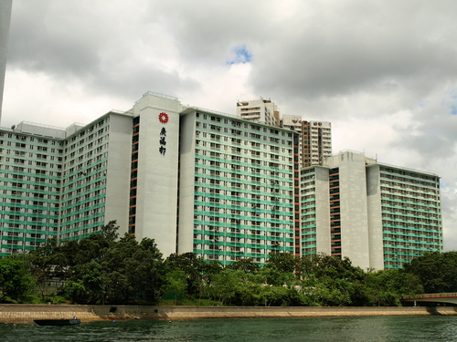
Private Space?
A typical flat in a public housing estate
Notes:
Source: http://mw2.google.com/mw-panoramio/photos/medium/25657078.jpg
Source: http://tkfiles.storage.live.com/y1pPVQf4A71_mC8XZ6HE8ah86g0LrC6Kw0fB0sIafbKF6KEKyh1dLCbojv4mMiXrc0oU19DvodOq68

Slide 24
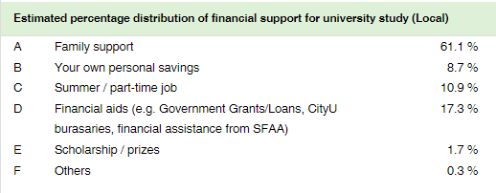
Financial Support (local)

Slide 25
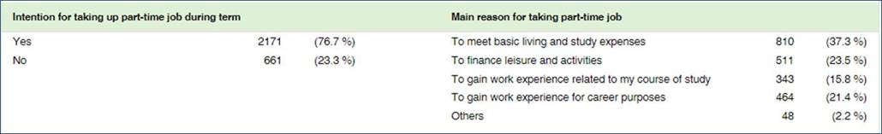
Part-time jobs

Slide 26
Surprise or expected?

Slide 27
Challenges
Recalling your first day at the university…
Padlet!

Slide 28
Challenges
In general, our students do not
make the transition from secondary school to university easily
have any clear goals for university and beyond

Slide 29
Opportunities
You can enrich their university experience!

Slide 30
Teaching Confidence: Teaching Assistants’ Reality Shock
Phase 4: Resolution
Phase 2: Shock
Phase 1: Honeymoon
A study of graduate teaching assistants’ self-efficacy in teaching: Fits and starts in the first triennium of teaching, PHP Chiu, P Corrigan - Cogent Education, 2019

Slide 31
Assessment!
pe of Assessment Tasks/Activities
Individual presentation (simulated teaching session with interactive student learning activities and assessment plan)
OBTL
About 10 mins

Slide 32
Course Readings
Formative assessment in higher education: Moves towards theory and the enhancement of pedagogic practice. Mantz Yorke . Centre for Higher Education Development, Liverpool John Moores University. UK Higher Education, 45(4), 477-501.
Improved learning in a large-enrollment physics class. Deslauriers, L., Schelew, E., & Wieman, C. (2011). Science, 332(6031), 862-864.
Graduate students' teaching experiences improve their methodological research skills. Feldon, D. F., Peugh, J., Timmerman, B. E., Maher, M. A., Hurst, M., Strickland, D., et al. (2011). Science, 333(6045), 1037-1039.
A study of graduate teaching assistants’ self-efficacy in teaching: Fits and starts in the first triennium of teaching. Chiu, P. H. P., Corrigan, P., & Hui, S. K. F. (2019).. Cogent Education, 6(1). https://doi.org/10.1080/2331186X.2019.1579964

Slide 33


